Slide 1
Introduction to Operating Systems
CPSC/ECE 3220
Lecture Notes
OSPP Chapter 4A
(adapted by Brygg Ullmer from Mark Smotherman’s adaptations of Tom Anderson’s slides on OSPP web site)

Slide 2
Threads: key takeaways
Threads are key for engaging parallelism
But code is hard to get correct when multiple threads can update shared objects
“[N]on-trivial multi-threaded programs are incomprehensible to humans.” Edward Lee, UCB / CPS
But: reframing of “trivial” and “embarrassingly parallel”
“For most purposes proposed for threads, events are better. Threads should be used only when true CPU concurrency is needed.” John Ousterhout
Different takeaways from above

Slide 3
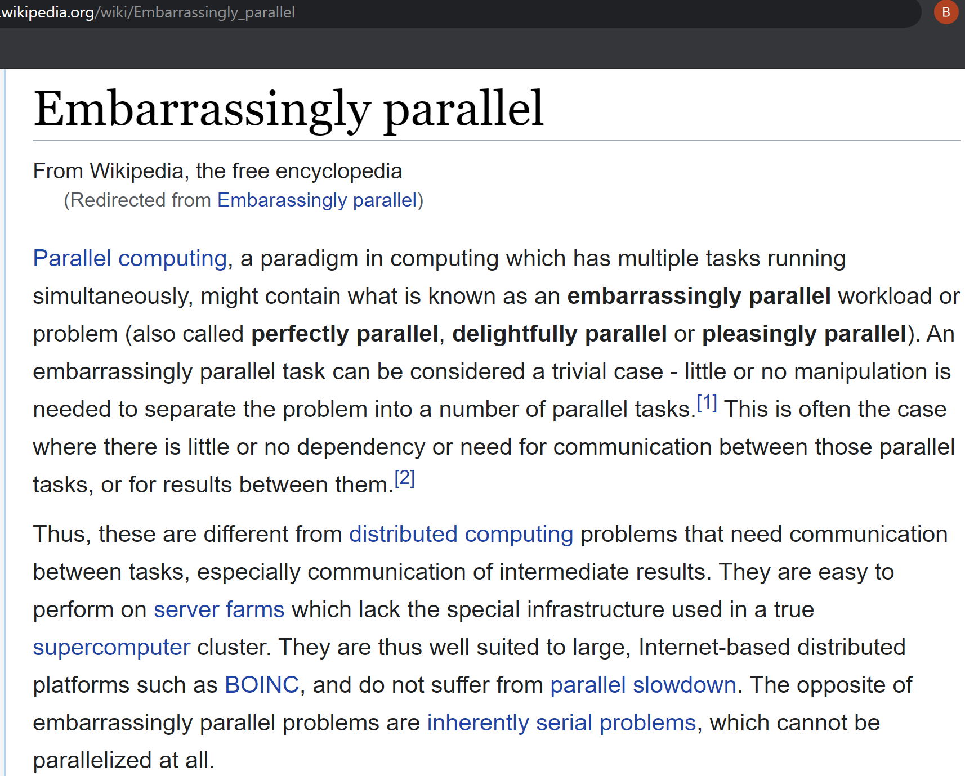

Slide 4
Four reasons to use threads
Program structure: expressing logically concurrent tasks
Potentially entangled with 2 and 3; ex1=UI; ex2=web server
Potentially varying by programming language
Responsiveness: shifting work to run in background
Performance: exploiting multiple processors
Performance: managing I/O devices

Slide 5
Thread Operations
thread_create(thread, func, args)
Create a new thread to run func(args)
thread_yield()
Relinquish processor voluntarily
thread_join(thread)
In parent, wait for forked thread to exit, then return
thread_exit(return_value)
Quit thread and clean up, wake up joiner if any

Slide 6
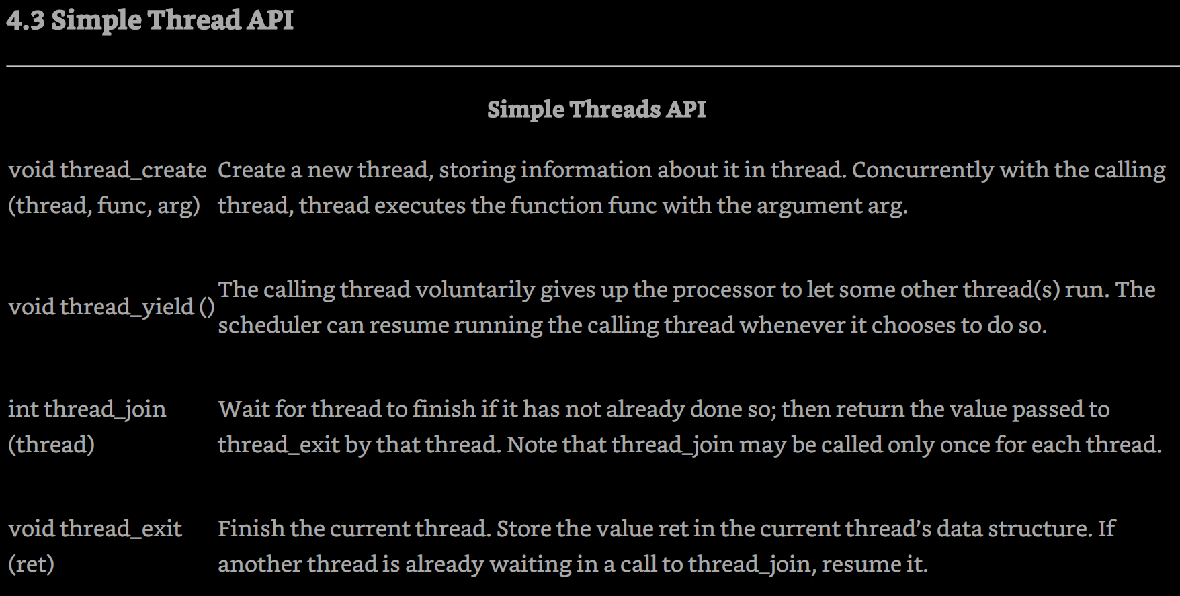

Slide 7
Example: threadHello
#define NTHREADS 10
thread_t threads[NTHREADS];
main() {
for (i = 0; i < NTHREADS; i++) thread_create(&threads[i], &go, i);
for (i = 0; i < NTHREADS; i++) {
exitValue = thread_join(threads[i]);
printf("Thread %d returned with %ld\n", i, exitValue);
}
printf("Main thread done.\n");
}
void go (int n) {
printf("Hello from thread %d\n", n);
thread_exit(100 + n);
// REACHED?
}

Slide 8
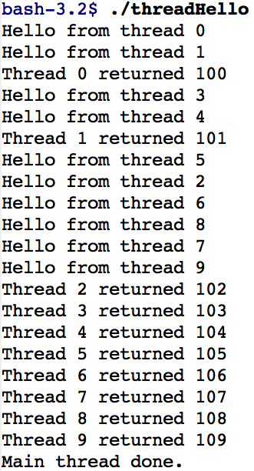
threadHello: Example Output
Why do some “Hello” messages print out of order?
Why must “thread returned” print in order?
What is maximum # of threads running when thread 5 prints hello?
Minimum?

Slide 9
Fork/Join Concurrency
Threads can create children, and wait for their completion
Data can be shared before fork and after join
Otherwise extra code to coordinate access (Chapter 5)
Examples:
Web server: fork new thread for each new connection
As long as the threads are completely independent
Merge sort
Parallel memory copy

Slide 10
Asynchronous I/O as a Alternative to Threads

Slide 11
Event-Driven Approach
Ousterhout description:
One execution sequence; no concurrency
Establish callbacks for events
Event loop waits for an event and invokes handlers
No preemption of event handlers
Event handlers are generally short-lived
But must add “continuation” data structures if event processing is complex and needs local state and tracking of next step

Slide 12
Question
When is event-driven programming better than multithreaded concurrency? Why?

